Slide 1
Writing Tests with Pester
Adam Bertram / Ashley Mcglone

Slide 2
Why Bother with Testing?
"It takes up too much time.“
"What's the point?“
"It's just PowerShell."

Slide 3
Benefits Of Unit Testing
THE BIG
RED BUTTON
CREATES A "SNAPSHOT" IN TIME
DEFINES "WORKING"
PREVENTS REGRESSION BUGS
ENABLES TRUST IN YOUR CODE
FORCES BETTER CODING PRACTICES

Slide 4
Testing is a Skill
"Functional" code and
test code are different
Good tests require
different thinking

Slide 5
Slide: Pester's Origination Story
1st
2nd
3rd
Created by
Jakub Jareš
Open Source
Installed with
Windows 10

Slide 6
Testing "Layers"
ACCEPTANCE TESTS
ITEGRATION TESTS
UNIT TESTS

Slide 7
Our Todos
Getting Started
Writing Tests for a PowerShell Project
Automating DSC Configuration Tests
Writing Tests for the PowerShell Gallery
Setup
Syntax
Test design
Mocking

Slide 8
ASSUMPTIONS
x
Powershell Skills
No Experience
With Pester

Slide 9
Using TDD to Build a Function
Test-Driven Development
Create tests for a function
Ensure those tests fail
Write code to make the tests pass
Project

Slide 10
Mocking
"OVERWRITES"
FUNCTIONS
ALLOWS CONTROL OVER CODE EXECUTION

Slide 11
Writing Tests for PowerShell
CSV --> AD sync tool
Script--> Refactor into functions --> Module
Full testing along the way

Slide 12
Writing Tests for DSC Configurations
Infrastructure
Testing
Introducing
Test Automation

Slide 13

Test Domain Creator
Given a single VM, it creates
An Active Directory Domain
Groups
OUs
Users

Slide 14
A Simple Release Pipeline
Commit to Source Control
Invoke build
script
Build the domain
Pass/Fail
build
Publish to PowerShell Gallery
Run test

Slide 15

What We've Learned
1
2
3
4
5
DIFFICULT
TO GET
STARTED
FORCE BETTER
CODE
GROW
TRUST
TURNS “SCRIPTS”
INTO CODE
AUTOMATE
IT!

Slide 16
Demo Resources
GITHUB: bit.ly/PSSummit17UnitTesting

Slide 17
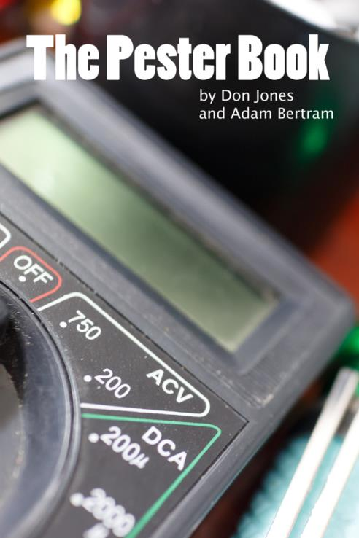
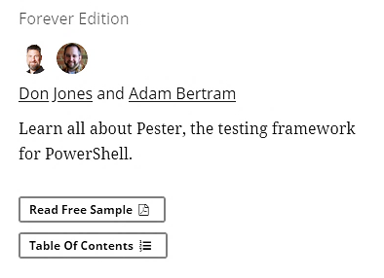
The Pester Book
https://leanpub.com/the-pester-book

